Slide 1
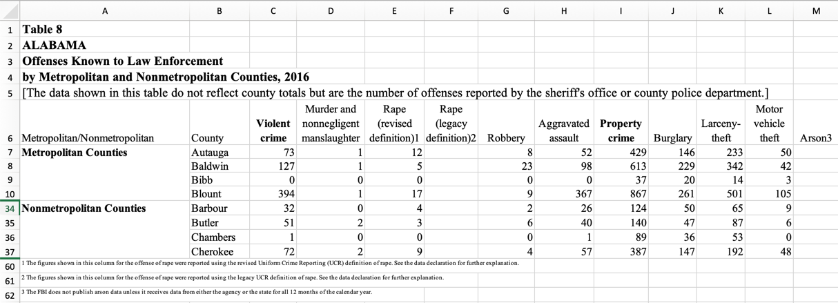
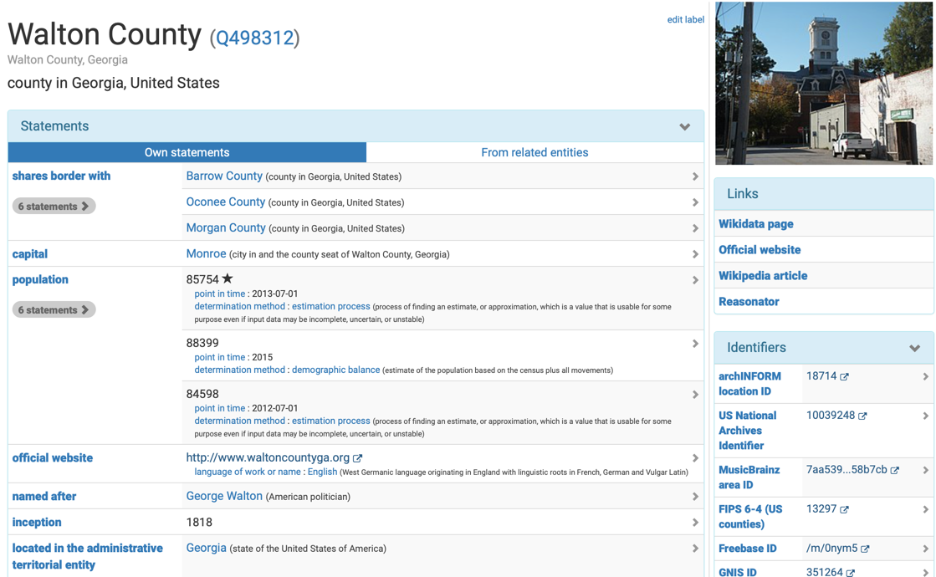
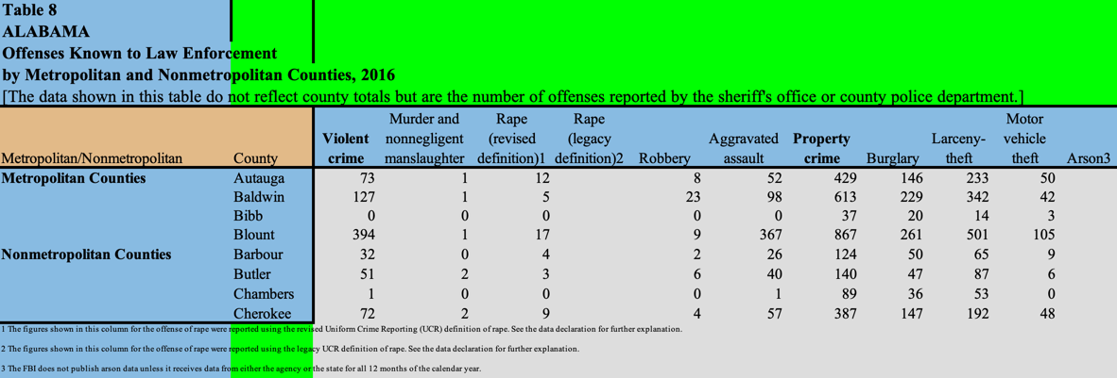
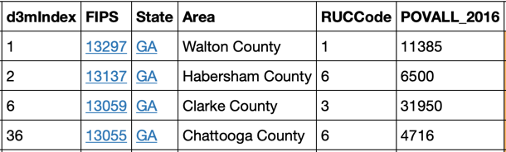
Datamart Discover ● Improve ● Augment ● Share
crime
econ
sports
shop-ping
weather
60 M items
700 M statements
3 million contributors
web
USC/ISI
Datamart
WIKIDATA satellites
raw data: hard to find & use
Metadata
Table Models
ready to use data for data-driven models
hub for dataset discovery with semi-automatic ETL
Table Models: semi-automated ETL workflows to transform raw data into knowledge elements
Metadata
Extraction
Entity
Linking
Table
Understanding
Semantic
Mapping
Notes:
Building good data-driven models requires good data. Practitioners spend a significant amount of time finding relevant data and curating it for use in their models. The goal of Datamart is to streamline this process to make it easy to discover and curate data, to use this data to augment existing data, and to share the curated data for future use. The Datamart project is building technology to create the largest publicly available knowledge graph. At the core of Datamart is Wikidata, a publicly available knowledge graph that already contains over 60 million entities, and thanks to a vibrant community of contributors it is growing at a rate of about 5 edits per second. The key idea in Datamart is to enable communities of interest to build satellite knowledge graphs that contain detailed knowledge in domains of interest. For example, Wikidata has data about every county in the US, including location, population, area, etc, it does not have data about crime, eg, number of homicides, burglaries, etc. This data exists in the Web in web sites such as the FBI and police departments, but is available in spreadsheets that require significant ETL to be used in data-driven models.
Datamart is developing tools to automate the ETL process to make data available in millions of spreadsheets and CSV files useful in data-driven models. Datamart provides tools to automatically extract metadata and to link entities mentioned in datasets to items in the Wikidata knowledge graph. By doing so, Datamart makes it easy to find relevant data for any application. Datamart also provides table understanding tools that identify useful blocks of data in spreadsheets and CSV files and automates extraction of data from these files. In addition, Datamart makes it easy for users to map the extracted data to the Datamart knowledge graph to populate the Wikidata satellite knowledge graphs. The ETL process is captured in Table Models that are themselves available in Datamart, enabling anyone to use them. Datamart enables communities of interest to build satellite knowledge graphs using non-public data by instantiating them behind their firewalls using the publicly available Table Models.
We are currently working on building crime, development indicator and sports satellite knowledge graphs, developing the table models that allow anyone to instantiate these satellites and use them an augment them for their own applications.

